Slide 1

Lyriqz
A music App

Slide 2

Agenda
About the App
Key Features
Functionality
Upcoming features
Summary

Slide 3
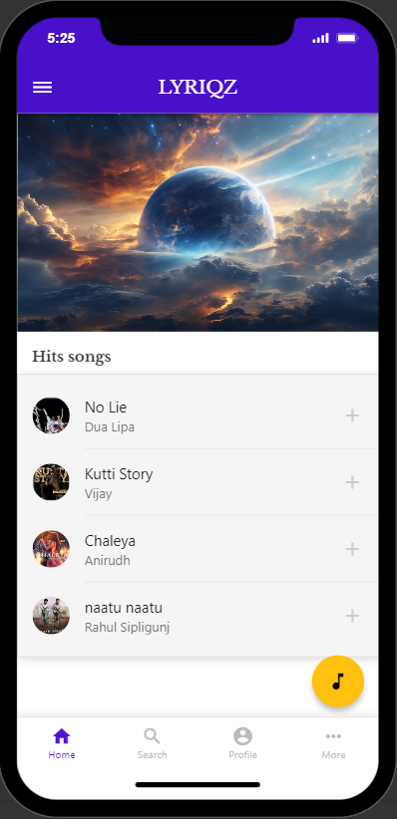
Introduction
It’s a music app which has user-friendly interface which helps you to effortlessly navigate through personalized recommendations, favourites and many more. Whether you're a casual listener or a dedicated music enthusiast, dynamic algorithms adapt to your preferences, continually refining its suggestions for an ever-evolving soundtrack.

Slide 4
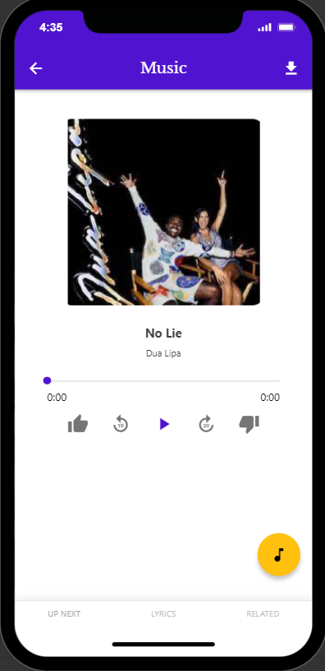
Key Features
High quality audio streaming.
Offline mode.
With social integration, share your favorite tunes, collaborate on playlists, and connect with fellow music lovers.
Shazam integration.
Notes:
is achieved through a combination of advanced technologies, careful encoding, and efficient transmission methods.
Can listen to music anywhere and anytime even without internet using offline mode.

Slide 5
Functionality
https://app.adalo.com/apps/adb4552c-9368-469d-97bf-eec335c91f4d/screens/preview

Slide 6

Upcoming features
Cross-Platform Compatibility
Concert and Event Integration
Sleep Timer
Smart Recommendations
Integration with Fitness Apps
Notes:
Ensure your app is available on multiple platforms (iOS, Android, web) and compatible with various devices to reach a broader user base.
information about upcoming concerts, events, and tours related to artists in the user's library, enhancing the overall music experience.
sleep timer feature that allows users to set a duration for playback before the app automatically stops, which can be useful for those who listen to music before sleeping.
Implement AI-driven recommendations that consider not only a user's listening history but also the time of day, location, and current mood.
providing users with motivational and energizing music during their workouts.

Slide 7
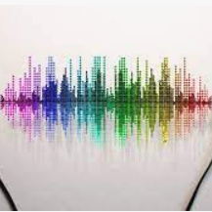
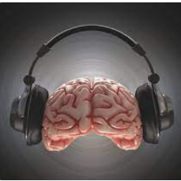
Summary
This app combines a user-friendly interface with a diverse and extensive music library, allowing users to discover, stream, and personalize their music experience. With a lot of cool features which will help the users to enjoy the music and get lost in the world of music.

Slide 8

Check out the app in your phone

Slide 9

Audience ideas?

Slide 10
THANK YOU
Arun krishna
FOS/BCS/21-21/003
Bsc computer science

